Slide 1
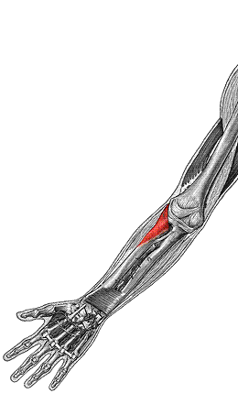
Supinator
O: humerus, ulna
I: radius
F: supinate forearm

Slide 2
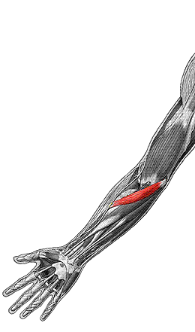
Pronator teres
O: medial epicondyle of humerus, ulna
I: radius
F: pronate forearm

Slide 3
Flexors of Forarm

Slide 4
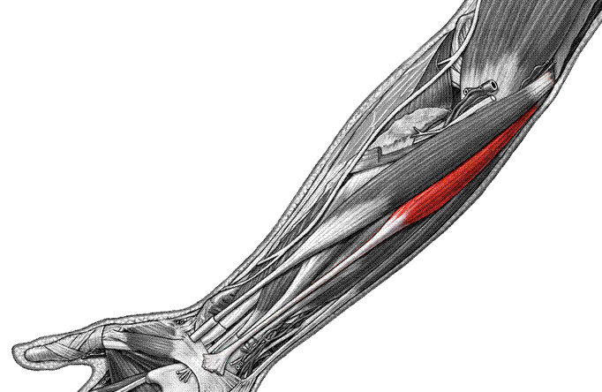
Palmaris longus
O: medial epicondyle of humerus
I: palmar aponeurosis
F: flex hand

Slide 5
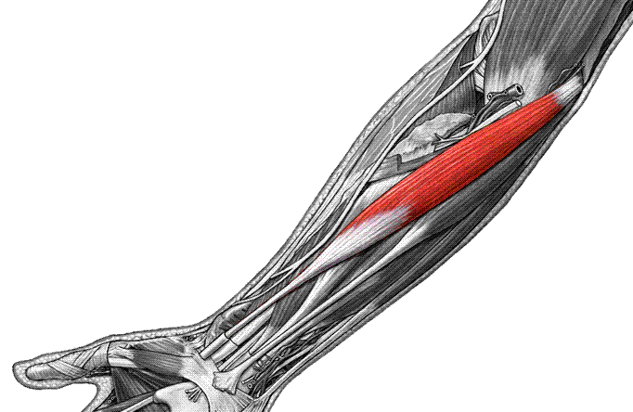
Flexor carpi radialis
O: medial epicondyle of humerus
I: 2nd, 3rd metacarpals
F: flex, abduct hand

Slide 6
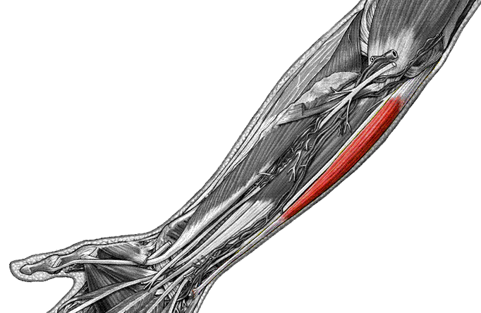
Flexor carpi ulnaris
O: medial epicondyle of humerus, ulna
I: carpals, 5th metacarpal
F: flex and adduct hand

Slide 7
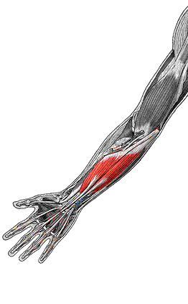
Flexor digitorum superficialis
O: humerus, ulna, radius
I: middle phalanges 2-5
F: flex hand, phalanges

Slide 8
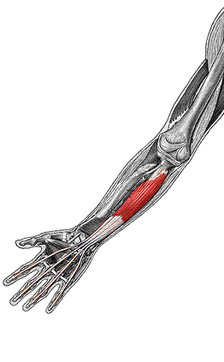
Flexor digitorum profundus
O: ulna
I: distal phalanges 2-5
F: flex hand, phalanges

Slide 9
Extensors

Slide 10
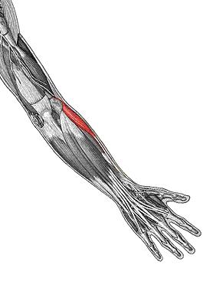
Extensor carpi radialis longus
O: humerus
I: 2nd metacarpal
F: extend and abduct hand

Slide 11
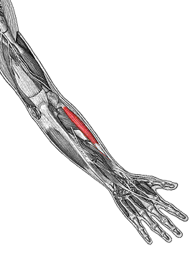
Extensor carpi radialis brevis
O: lateral epicondyle of humerus
I: 3rd metacarpal
F: extend & abduct hand

Slide 12
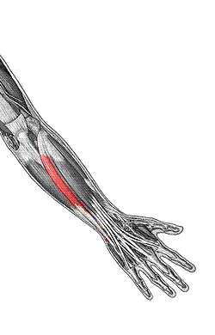
Extensor carpi ulnaris
O: lateral epicondyle of humerus
I: 5th metacarpal
F: extend, adduct hand

Slide 13
Extensor digitorum
O: lateral epicondyle of humerus
I: distal phalanges 2-5
F: extend hand & phalanges

Slide 14
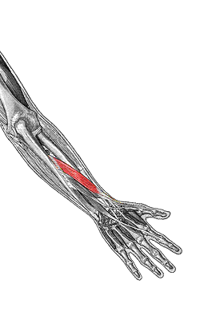
Abductor pollicis longus
O: radius, ulna
I: 1st metacarpal
F: abduct thumb

Slide 15
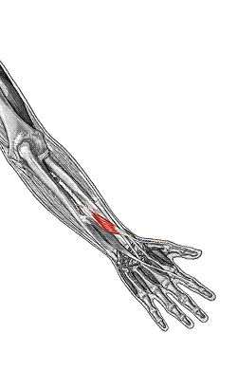
Extensor pollicis brevis
O: radius, ulna
I: thumb phalanges
F: extend thumb

